Slide 1
Digital Messaging Workshop
August, 2021
Brought to you by the New Hampshire Young Democrats

Slide 2
Welcome, candidates!

Slide 3
Digital Messaging Workshop
Agenda
Introductions
Digital : One Tool in the Toolbox
Digital Messaging: What to Communicate
Social Media Platforms
Who you’re reaching, What & When to post
Intro to Facebook Ads
Intro to Campaign Logo & Design
Discussion: Messaging & Social Media Strategy
Social Media Calendar & Digital Tools

Slide 4
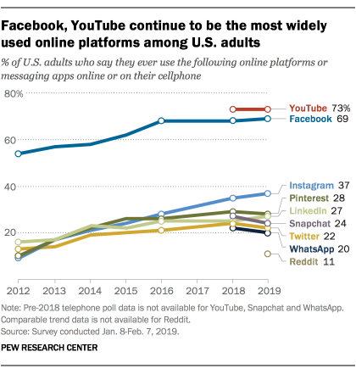
Table Setting
Be thoughtful in how you spend your time on social media.
Know what it can do for your campaign, and what it cannot.
Notes:
Table setting slide:
Digital enhances VC, not a replacement
Communicate w/ current supporters to drive fundraising and show other orgs you are working
Place where voters can find you--
Doesn’t mean that all the voters that you want to find you, will find you. Social media isn’t targeted
Difference between “organic” social media vs. paid social media
https://www.pewresearch.org/fact-tank/2019/08/02/10-facts-about-americans-and-twitter/
https://www.pewresearch.org/fact-tank/2019/05/16/facts-about-americans-and-facebook/

Slide 5
Digital Messaging
What to message online:
Tell & reinforce your story of self.
Focus on issues that your constituents/voters and donors/supporters care about
Highlight/showcase the work that you and your campaign are doing
Include calls to action
Be a resource for the community on state and local issues.
Public Profiles
Understand what is public and private, and what you are putting out there.

Slide 6
Social Media
Platforms & Messaging
What social media platforms does your campaign use?

Slide 7
Campaign on Social Media
(plz) Don’t
Do!
Solely rely on social media to reach voters you need to win
Spend a lot of time (or $) learning a new platform to campaign
Start a campaign account & never post
Integrate social media into your voter contact strategy
Campaign on platforms you are comfortable on (digi to your strengths!)
Be positively you!
Notes:
If you’re spending your time on social media, make sure your social media is helping you win!
Social media as a tool to get your message to your voters (+ others who can help you contact the voters you need to win)
Link platforms

Slide 8
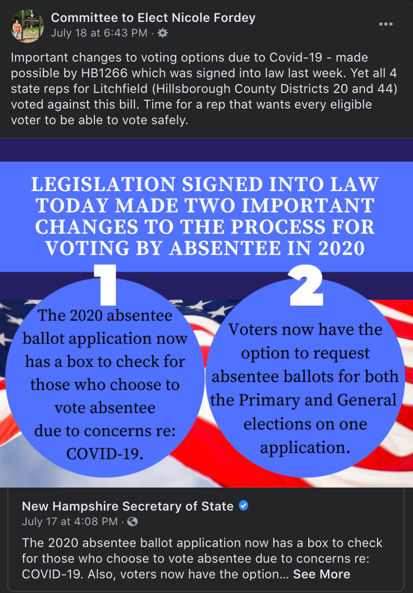
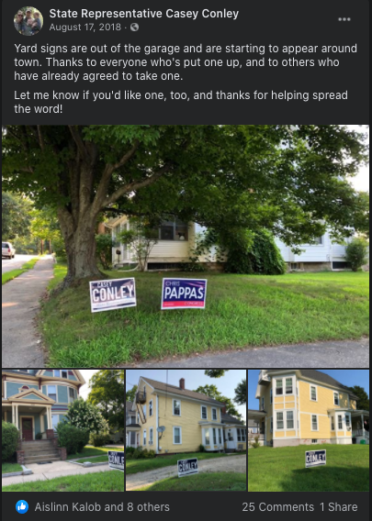
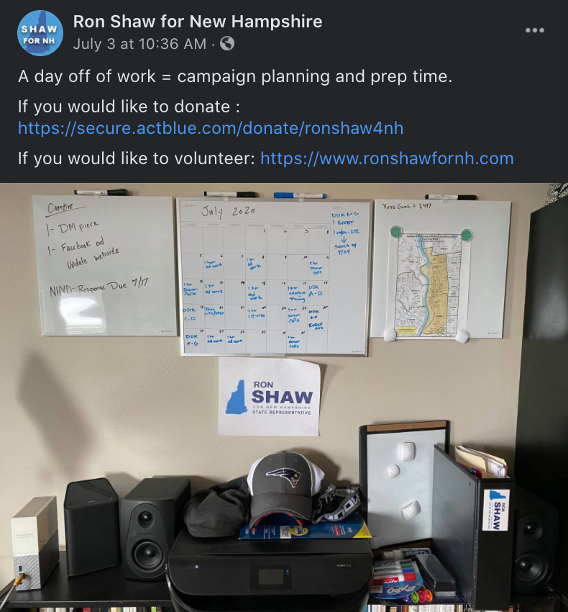
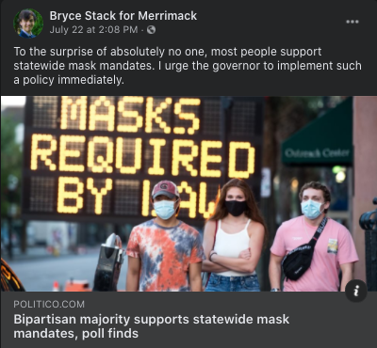
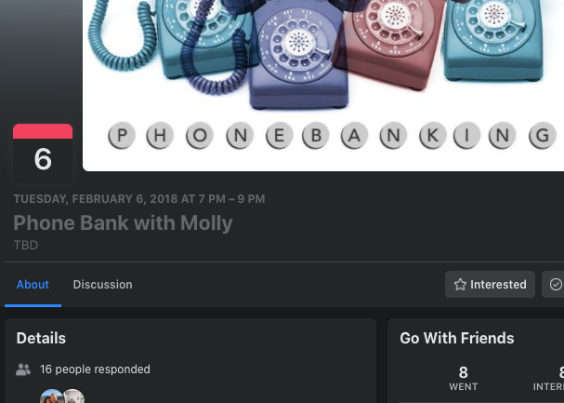
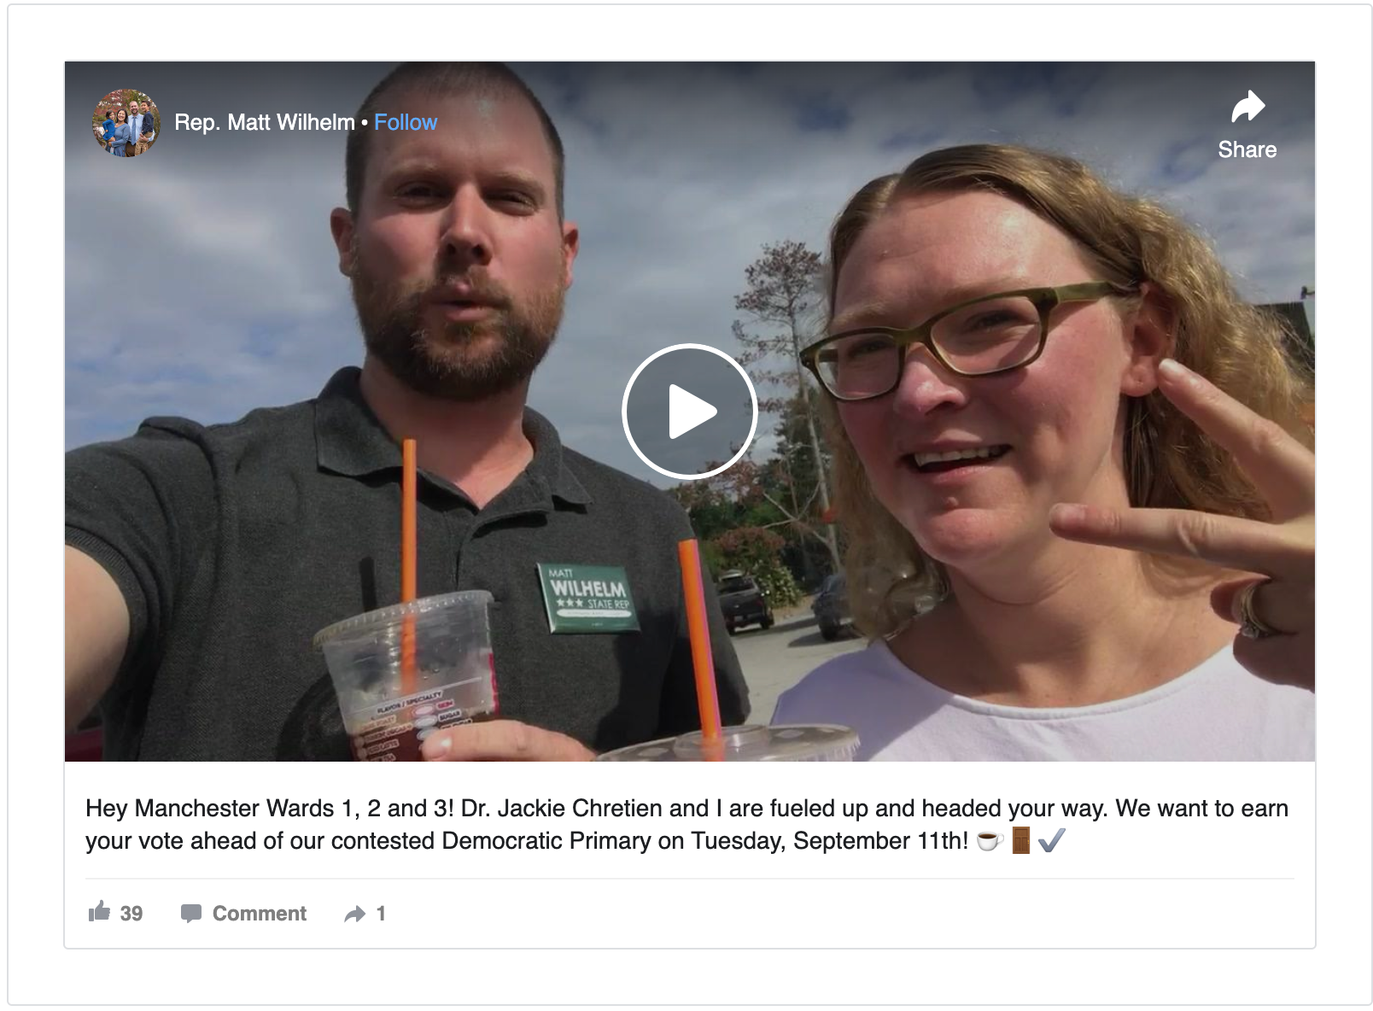
Facebook
Ways to Amplify Your Message on Facebook
Make sure you have a campaign page set up!
Audience
Widest, most diverse you will contact online
If a voter has social media- they probably have Facebook
Share the work you are doing to get elected
Keep it local (use your judgement on the occasional hot take)
Amplify and build for fundraisers & voter contact events
Elevate engagements
Collab with other candidates!

Slide 9
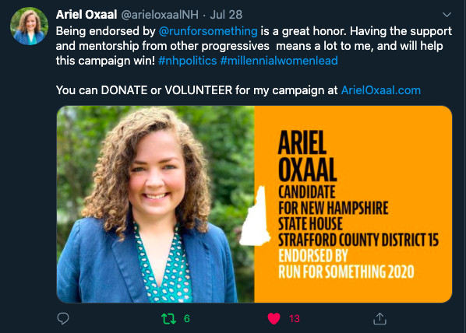
Twitter
Ways to Amplify Your Message on Twitter
Make sure you have a campaign twitter profile set up
Audience
Narrow audience - politically interested, media consumers
Less rooted in geography- you may reach few or no target voters
Keep it #nhpolitics
Show yourself working!
Share stories from the trial
Comment on state issues
Always be fundraising...
Notes:
https://twitter.com/pwcdanica/status/1001982212995256324

Slide 10
Websites & Instagram
You don’t need a website to win.
Nor an insta.
(But they can
be helpful)
Notes:
Use your own Insta. Websites needed if you aren’t doing your own Facebook ads. If you make a website, and are running for state rep, make an inexpensive one and don’t put too much time into it.
https://www.instagram.com/brittneyfornh/

Slide 11
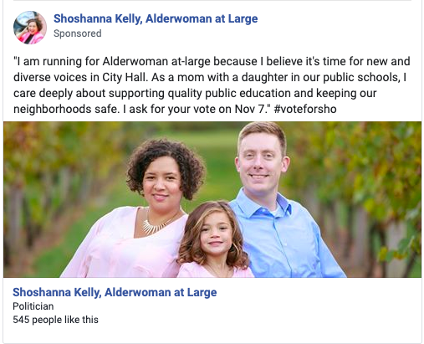
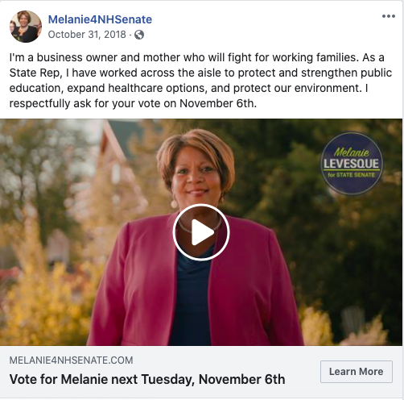
Intro to Facebook Advertising
Notes:
Why it's important- 70% of population is on there. It has really great targeting capabilities. Inexpensive, and quick and cheap to produce. You can reach people for 1/10th of the cost of mail. You can reach audiences with multiple messages in a condensed amount of time.
What are the challenges- Facebook makes you jump through a lot of hoops to run political ads. Targeting for city ward based-districts is a challenge (but not impossible).
Next Steps-> Start the verification process. I will mentor YD candidates on Facebook ads if asked.

Slide 12
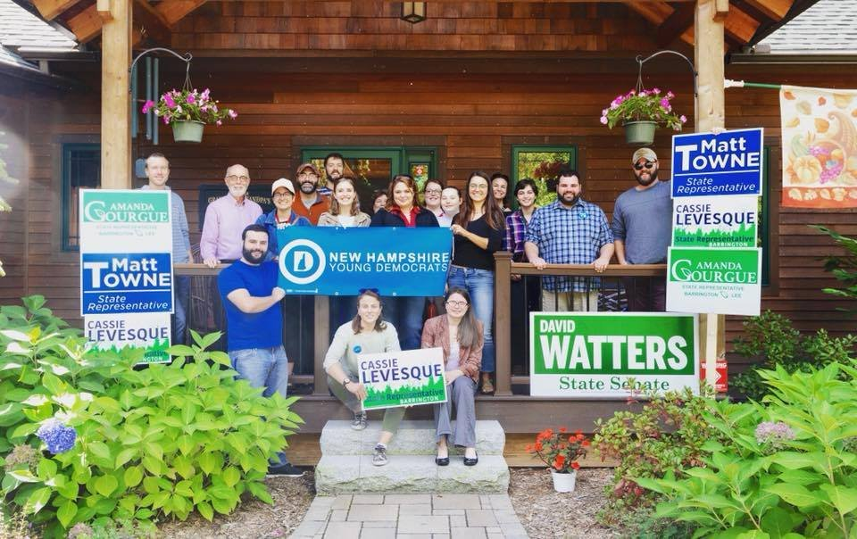
Intro to Campaign Logo & Design
Principles of Campaign Design
Keep it simple - Less is more
$
$
2. Key info: Name, City/Town, Office
3. Primary candidates - Primary date
$
4. If printing- remember colors cost
5. Use the space (grandmother test)

Slide 13
Adobe
Campaign Logo & Design Tools

Slide 14
Breakout Session
Discussion Questions
What is the “main thread” of your story of self?
How will you use digital to repeat and reinforce your core message and key issues?
How will you use digital to bring supporters “up the ladder of engagement”?
Notes:
Main thread of your story of self
Why are you called to serve/what motivates you to serve?

Slide 15
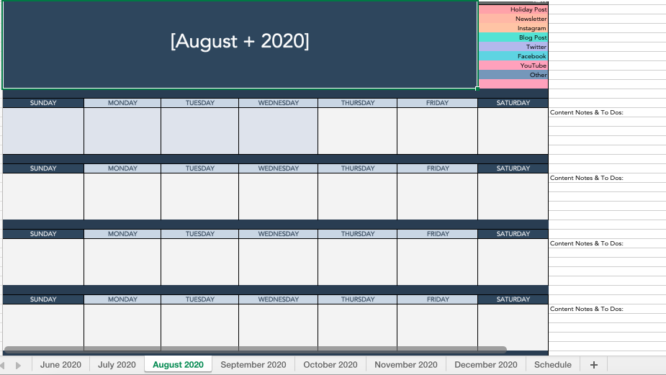
Social Media Calendar & Digi Tools
Free social media management tools
Tweet deck
Facebook Tools
Others...

Slide 16
Questions?
Thank you for joining!

Slide 17
This Training Provided Was Provided by the NHYD Elections Program
The New Hampshire Young Democrats have a proven track record supporting, advising, and fostering winning campaigns for young candidates. Established in 2008, the NHYD Elections Program works year-round to recruit, train, and elect the next generation of progressive leadership to local, state and federal offices.
NHYD is committed to providing the resources necessary to create the next generation of progressive political leaders in New Hampshire. The New Hampshire Young Democrats have supported over 180 young Democrats running in municipal and statewide campaigns to date.
Can you help support that work? Donate today via https://secure.actblue.com/donate/nhyoungdemocrats

Slide 18
Coming Soon:
Our intro to Canva Training
Create a free account → www.canva.com

